Slide 1
UNIT 3-Hopfield Networks
PROF.SHILPA GAIKWAD
TE AIDS

Slide 2
INTRODUCTION
Hopfield neural network was invented by Dr. John J. Hopfield in 1982.
It consists of a single layer which contains one or more fully connected recurrent neurons.
The Hopfield network is commonly used for auto-association and optimization tasks.

Slide 3
Discrete Hopfield Network
A Hopfield network which operates in a discrete line fashion or in other words, it can be said the input and output patterns are discrete vector, which can be either binary 0,1 or bipolar +1,−1 in nature.
The network has symmetrical weights with no self-connections i.e., wij = wji and wii = 0.

Slide 4
Architecture of Discrete Hopfield Network
Following are some important points to keep in mind about discrete Hopfield network −
This model consists of neurons with one inverting and one non-inverting output.
The output of each neuron should be the input of other neurons but not the input of self.
Weight/connection strength is represented by wij.
Connections can be excitatory as well as inhibitory. It would be excitatory, if the output of the neuron is same as the input, otherwise inhibitory.
Weights should be symmetrical, i.e. wij = wji

Slide 5
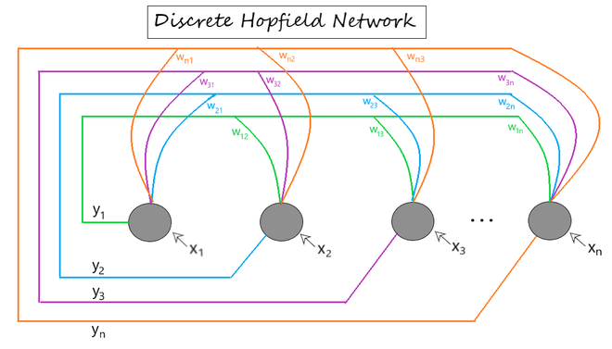
Fig 1 shows a sample representation of a Discrete Hopfield Neural Network architecture having the following elements.
Fig 1: Discrete Hopfield Network Architecture

Slide 6
[ x1 , x2 , ... , xn ] -> Input to the n given neurons.
[ y1 , y2 , ... , yn ] -> Output obtained from the n given neurons
Wij -> weight associated with the connection between the ith and the jth neuron.

Slide 7
Training Algorithm
During training of discrete Hopfield network, weights will be updated. As we know that we can have the binary input vectors as well as bipolar input vectors.
Hence, in both the cases, weight updates can be done with the following relation
Case 1 − Binary input patterns
For a set of binary patterns sp, p = 1 to P
Here, sp = s1p, s2p,..., sip,..., snp
Weight Matrix is given by

Slide 8
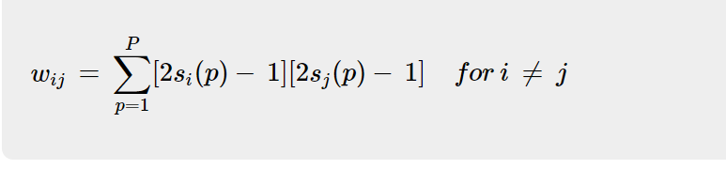
Weight Matrix is given by

Slide 9
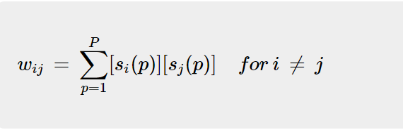
Case 2 − Bipolar input patterns
For a set of binary patterns sp, p = 1 to P
Here, sp = s1p, s2p,..., sip,..., snp
Weight Matrix is given by

Slide 10
Testing Algorithm
Step 1 − Initialize the weights, which are obtained from training algorithm by using Hebbian principle.
Step 2 − Perform steps 3-9, if the activations of the network is not consolidated.
Step 3 − For each input vector X, perform steps 4-8.
Step 4 − Make initial activation of the network equal to the external input vector X as follows −

Slide 11
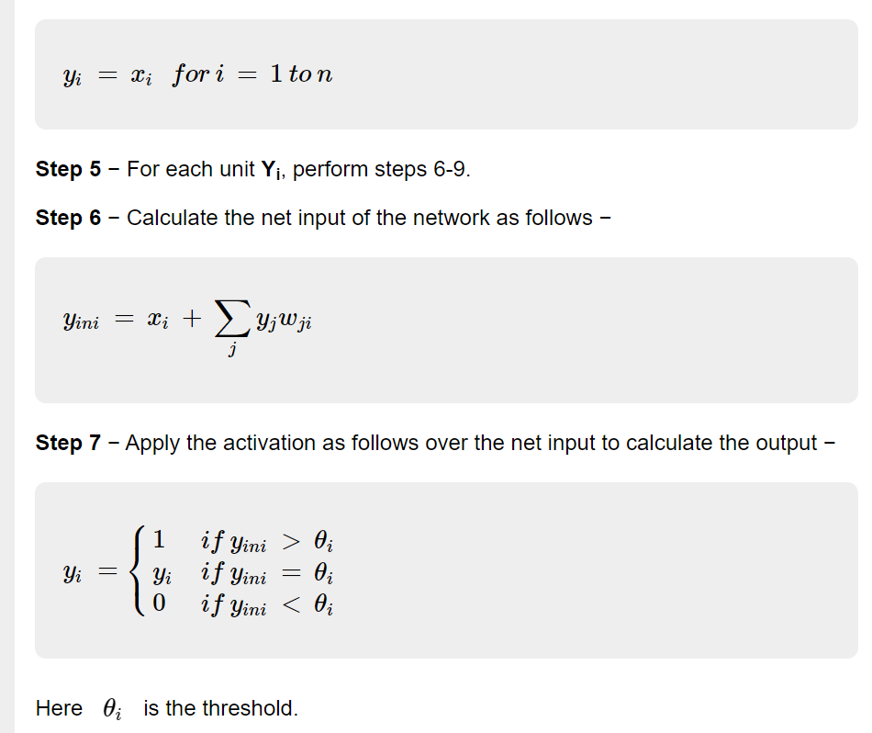

Slide 12
Step 8 − Broadcast this output yi to all other units.
Step 9 − Test the network for conjunction.

Slide 13
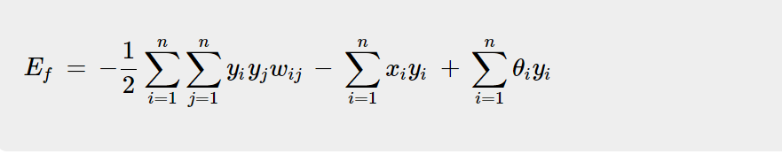
Energy Function Evaluation
An energy function is defined as a function that is bounded and non-increasing function of the state of the system.
Energy function Ef⁡, determines the stability of discrete Hopfield network, and is characterized as follows −

Slide 14
Energy Function Evaluation
Condition − In a stable network, whenever the state of node changes, the above energy function will decrease.
Suppose when node i has changed state from y(k)_{i} to y(k+1)_{i} ⁡then the Energy change ΔEf is given by the following relation

Slide 15
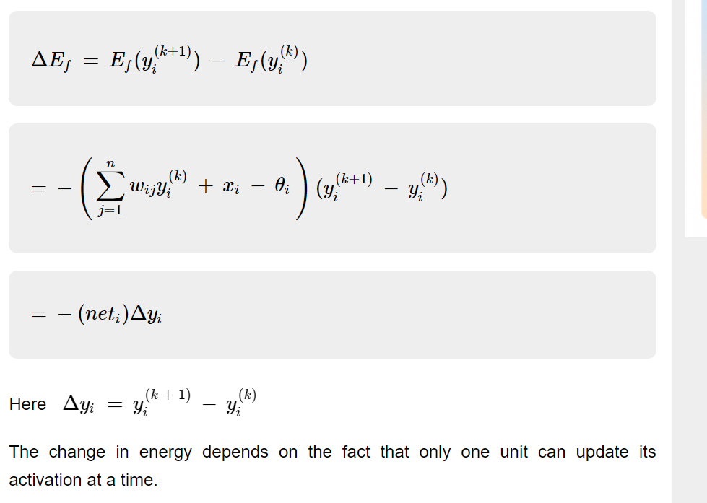
Energy Function Evaluation

Slide 16
Continuous Hopfield Network
Continuous Hopfield Network: Unlike the discrete hopfield networks, here the time parameter is treated as a continuous variable.
So, instead of getting binary/bipolar outputs, we can obtain values that lie between 0 and 1.
It can be used to solve constrained optimization and associative memory problems. The output is defined as:
v_{i} = g(u_{i})
where,
v_{i} = output from the continuous hopfield network
u_{i} = internal activity of a node in continuous hopfield network.

Slide 17
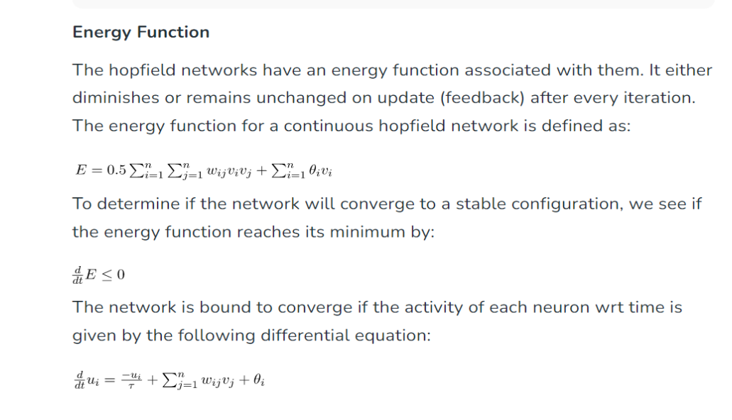
Energy function

Slide 18
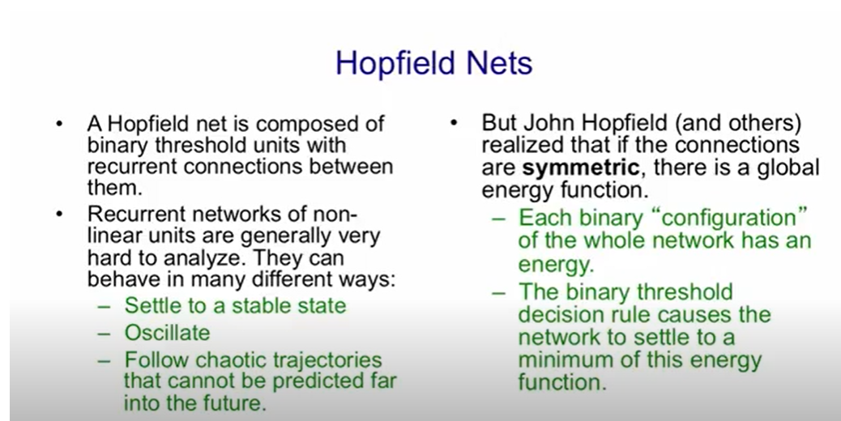
Energy performance in Hopfield network

Slide 19
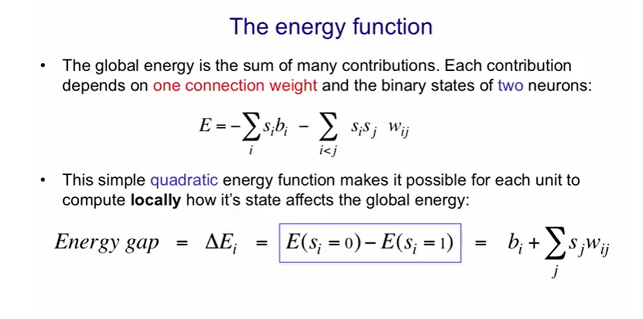

Slide 20
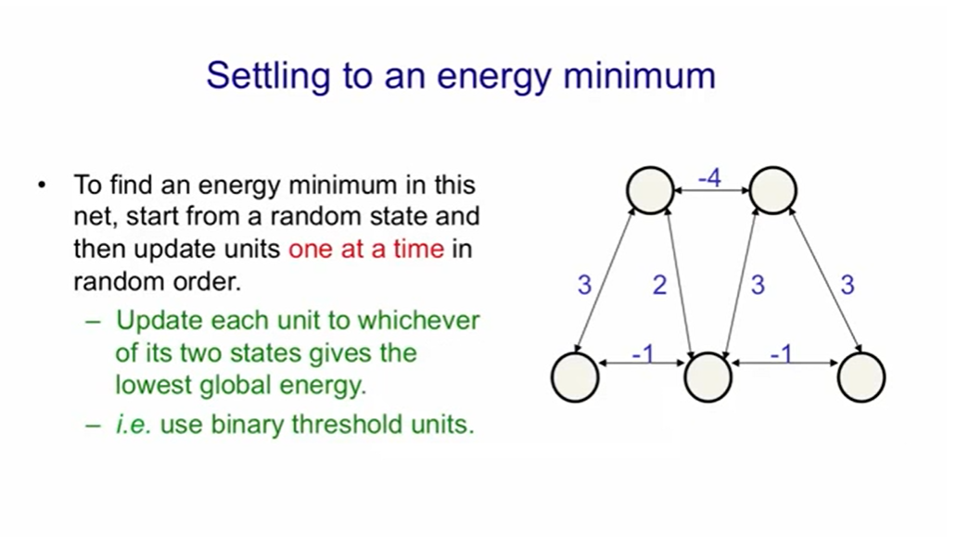

Slide 21
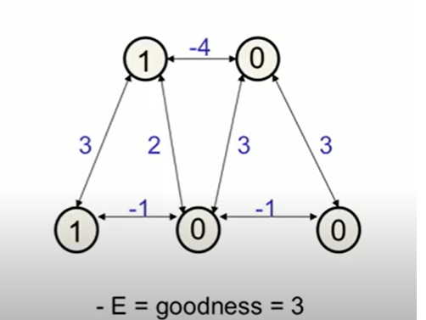
Fig.1

Slide 22
So let's look at a little example for the net in Fig 1 .We'll start with a random global state .
This was a carefully selected random State and that has an energy of minus three or a goodness of three.
It's easier to think about negative energies which will call goodness’s .
There aren't any biases here.
So to compute the goodness you just look at all pairs of units that are on and add in the weight between them
And in this configuration there's only one pair of units as active and that has a weight of three so we get a goodness of three.

Slide 23
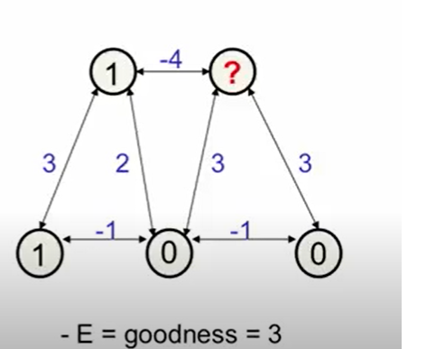

Slide 24

Now let's start probing the unit’s.
Let's pick a unit at random like that one and ask what state should that be in given the current states of all the other units.
So if we look at the total input to that it gets an input of 1 times minus 4 plus 0 times 3 plus another 0 times 3.
So guess a total input of minus 4 .
The total input =(1*-4)+(0*3)+(0*3)=-4
That's below 0 so we turn it off .That is it stays in the off State(Fig.2).

Slide 25
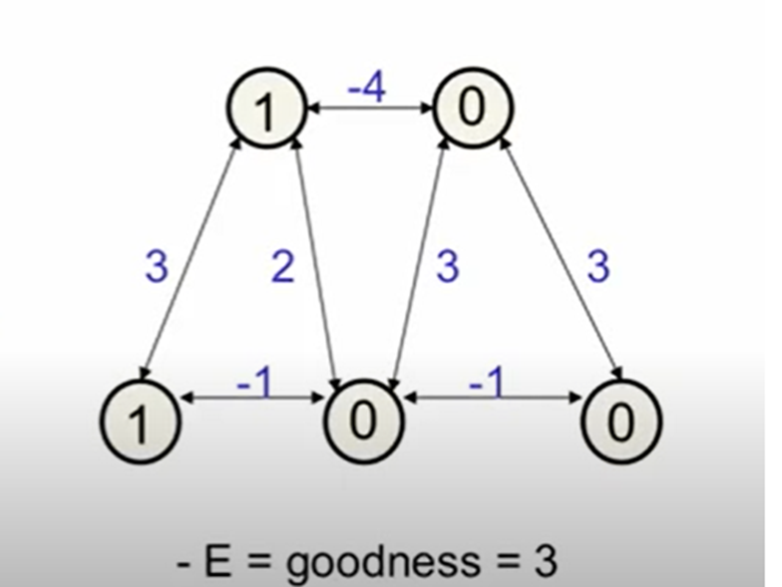
Fig 2

Slide 26
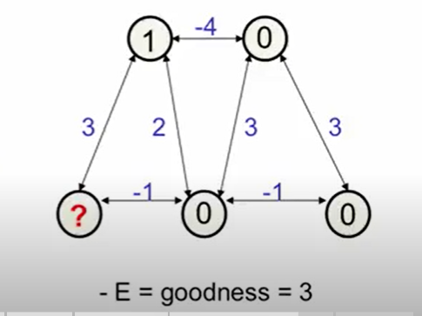
Fig.3

Slide 27
Now let's probe another unit (Fig 3).
If we look at this unit again it gets a total input of 1 times 3 plus minus 1 times 0 .
Total input=(1*3)+(-1*0)=3+0=3
So it gets a total input of 3 so the binary threshold decision rule will make it turn on.

Slide 28


Slide 29
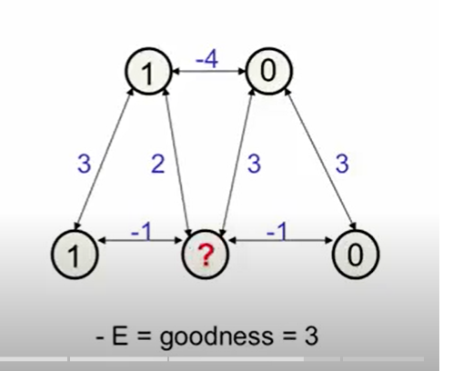

Slide 30
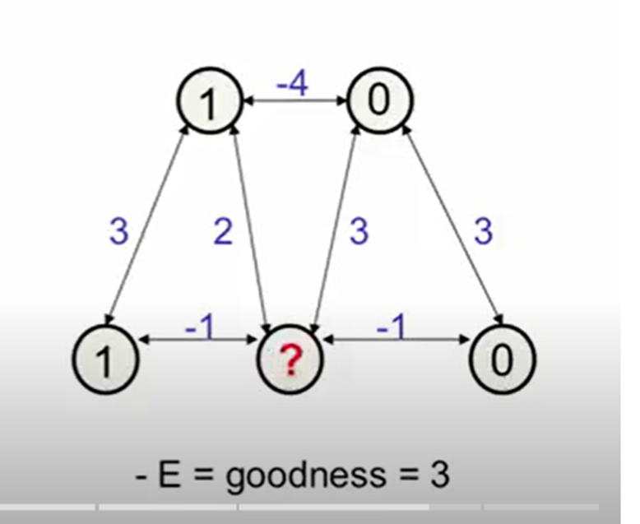
Let's probe one more unit.
This units more interesting it's getting an input of 1 times 2 plus 1 times minus 1 plus 0 times 3 plus 0 times minus 1.
Total input=(1*2)+(1*-1)+(3*0)+(0*-1)=2-1+0+0=1
So that's a total input of 1.
So it will now turn on, previously it was off .
And so when it turns on the global energy changes .
We now have the global energy of minus 4 or goodness of 4 and that's a local energy minimum.
If you now try probing any of the units you'll see that they don't want to change their current state .
The net is settle to a minimum .A deeper energy minimum.

Slide 31
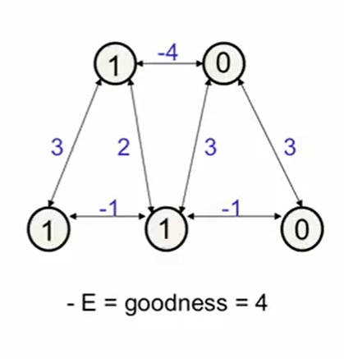

Slide 32
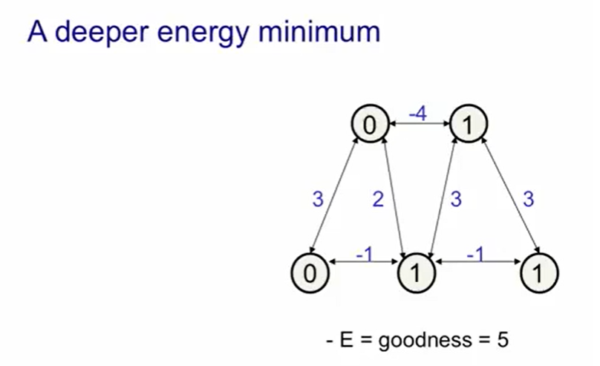
Fig.4

Slide 33
The deeper energy minimum
The deepest energy minimum is shown in Fig.4 .
And it's when the other triangle of units support each other is on
That has a goodness of 3 plus 3 plus minus 1 is 5.
-E=goodness=3+3-1=5
So that's a slightly better energy minimum.

Slide 34
